Slide 1



NTHU109 Introduction to Hardware Security
Final Project
EE21 林俊曄 張嘉祐 張薇 陳奕默

Slide 2
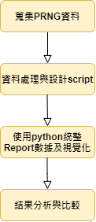
Design Flow Chart

Slide 3
Q1. How do you choose your input data size?

Slide 4

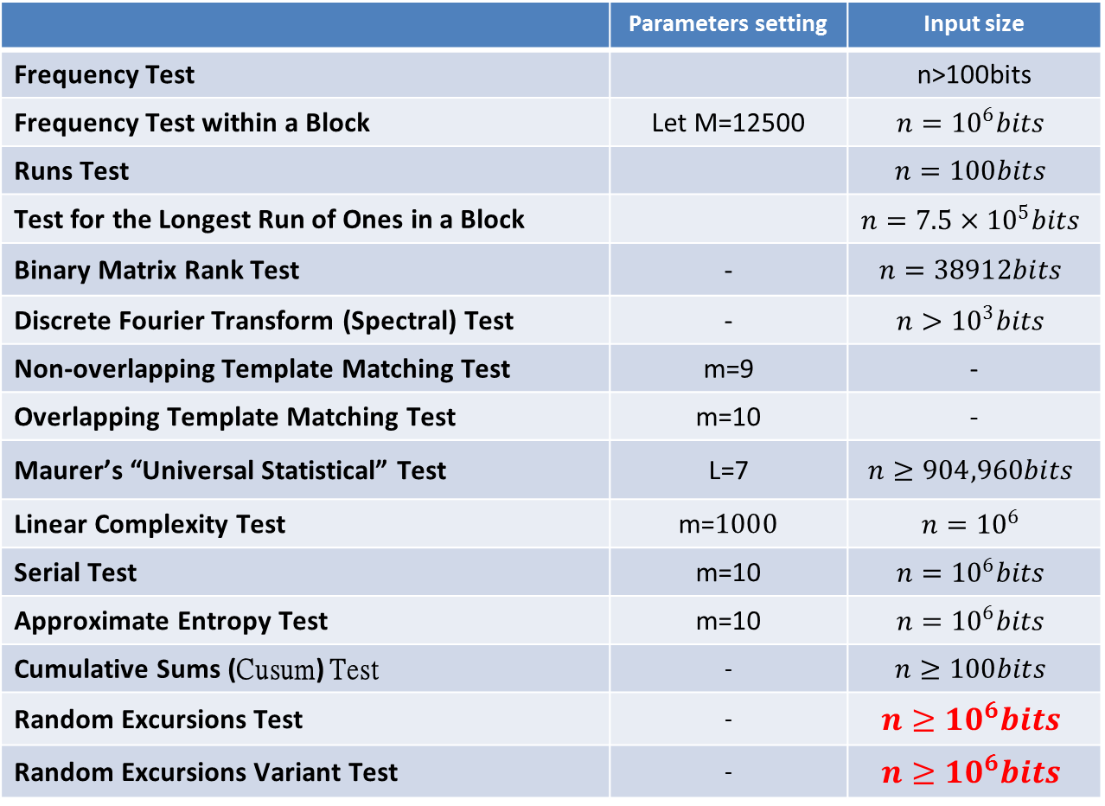
Task – Input Data Size: X(# of bits in a row)
 | Parameters setting | Input size
Frequency Test |  | n>100bits
Frequency Test within a Block | Let M=12500 | $$n={10}^{6}bits$$
Runs Test |  | $$n=100bits$$
Test for the Longest Run of Ones in a Block |  | $$n={7.5×10}^{5}bits$$
Binary Matrix Rank Test | - | $$n=38912bits$$
Discrete Fourier Transform (Spectral) Test | - | $$n>{10}^{3}bits$$
Non-overlapping Template Matching Test | m=9 | -
Overlapping Template Matching Test | m=10 | -
Maurer’s “Universal Statistical” Test | L=7 | $$n≥904,960bits$$
Linear Complexity Test | m=$1000$ | $$n={10}^{6}$$
Serial Test | m=10 | $$n={10}^{6}bits$$
Approximate Entropy Test | m=10 | $$n={10}^{6}bits$$
Cumulative Sums (Cusum) Test | - | $$n≥100bits$$
Random Excursions Test | - | $$n≥{10}^{6}bits$$
Random Excursions Variant Test | - | $$n≥{10}^{6}bits$$
所以我們取$X={10}^{6}$
以滿足所有test的要求

Slide 5
Task – Input Data Size : Y(# of sequence)
In Chapter 4.3(f) - Sample Size:
“NIST recommends that, for these tests, the user should fix the significance level to be at least 0.001.”
所以對於significance level=0.001的情形下
Y至少要1000行以上

Slide 6

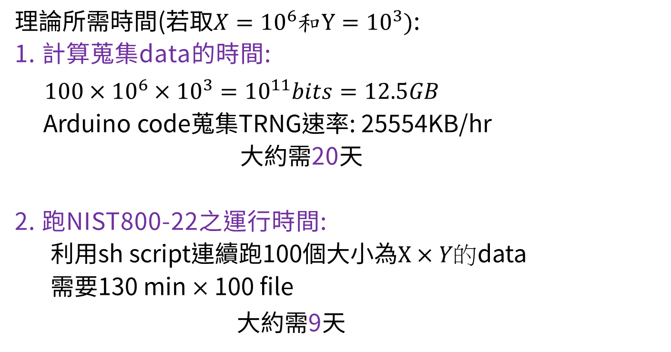
Task – Input Data Size : Y(# of sequence)
理論所需時間(若取$X={10}^{6}和Y={10}^{3})$:
1. 計算蒐集data的時間:
$100×{10}^{6}×{10}^{3}={10}^{11}bits=12.5GB$
Arduino code蒐集TRNG速率: 25554KB/hr
大約需20天
2. 跑NIST800-22之運行時間:
利用sh script連續跑100個大小為$X×Y的$data
需要130 min$×\text{1}\text{0}\text{0}$file
大約需9天
需花費太多時間!
所以我們決定Y取小些!

Slide 7
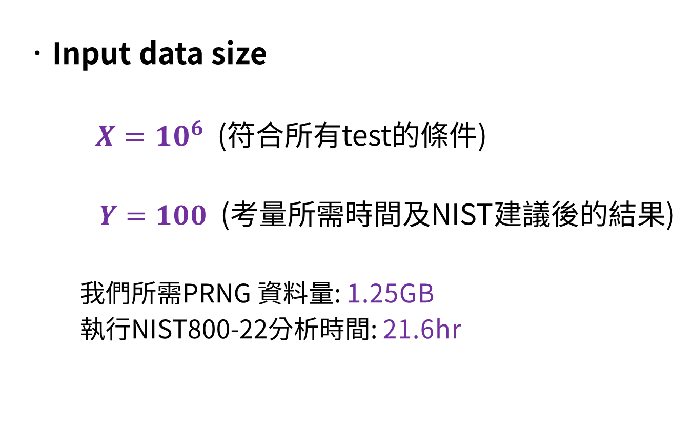
Task – Input Data Size
Input data size
$X={10}^{6}$ (符合所有test的條件)
$Y=100$ (考量所需時間及NIST建議後的結果)
我們所需PRNG 資料量: 1.25GB
執行NIST800-22分析時間: 21.6hr

Slide 8
Q2. How do you choose your parameter setting?

Slide 9
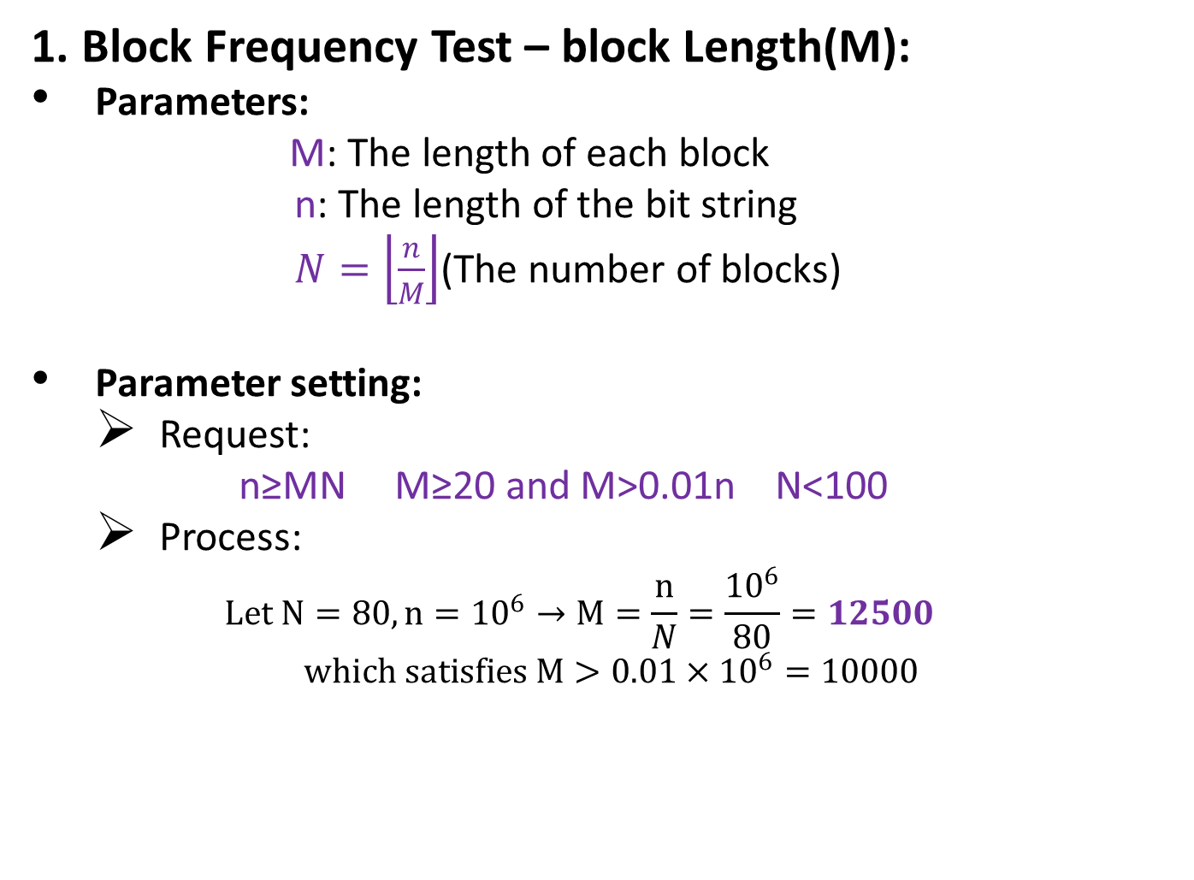
Task – Parameters Setting
1. Block Frequency Test – block Length(M):
Parameters:
M: The length of each block
n: The length of the bit string
$N=\left\lfloor \frac{n}{M}\right\rfloor$(The number of blocks)
Parameter setting:
Request:
n≥MN M≥20 and M>0.01n N<100
Process:
$$Let N=80, n={10}^{6}→M=\frac{n}{N}=\frac{{10}^{6}}{80}=12500$$
$$which satisfies M>0.01×{10}^{6}=10000$$

Slide 10
Task – Parameters Setting
2. NonOverlapping Template Test- block length (m):
Request:
m = 9 or 10 for meaningful results.
N = 8 (specified in the test code, N<100)
Process:
Let m=9

Slide 11
Task – Parameters Setting
3. Overlapping Template Test- block length (m)
Request:
NIST recommends m=9 or m=10
for the time being (暫時).
Process:
Let m=10

Slide 12
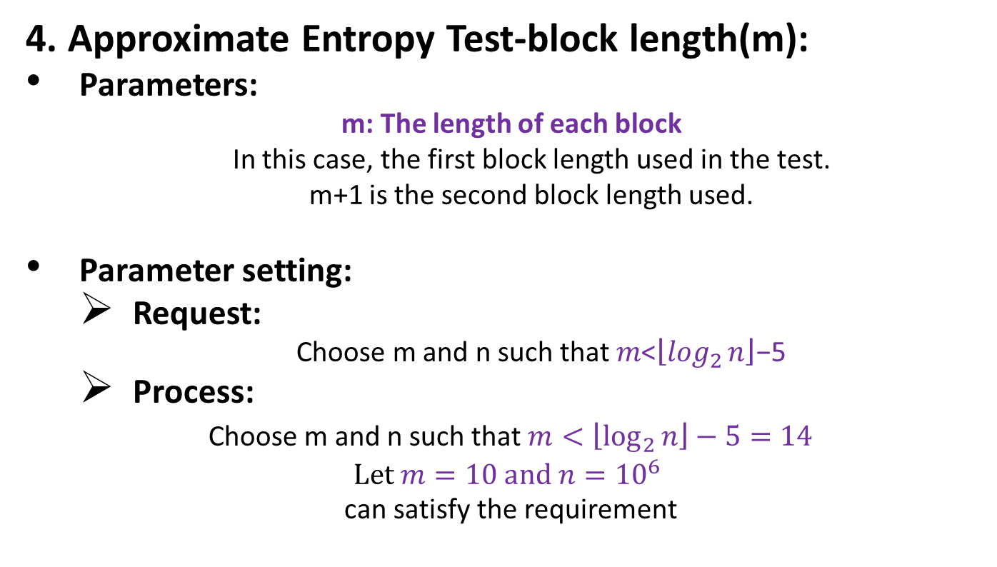
Task – Parameters Setting
4. Approximate Entropy Test-block length(m):
Parameters:
m: The length of each block
In this case, the first block length used in the test.
m+1 is the second block length used.
Parameter setting:
Request:
Choose m and n such that 𝑚<$\left\lfloor \log_{2}{n}\right\rfloor$−5
Process:
Choose m and n such that $m<\left\lfloor \log_{2}{n}\right\rfloor −5=14$
$$\text{L}\text{et} m=10 and n={10}^{6}$$
can satisfy the requirement

Slide 13
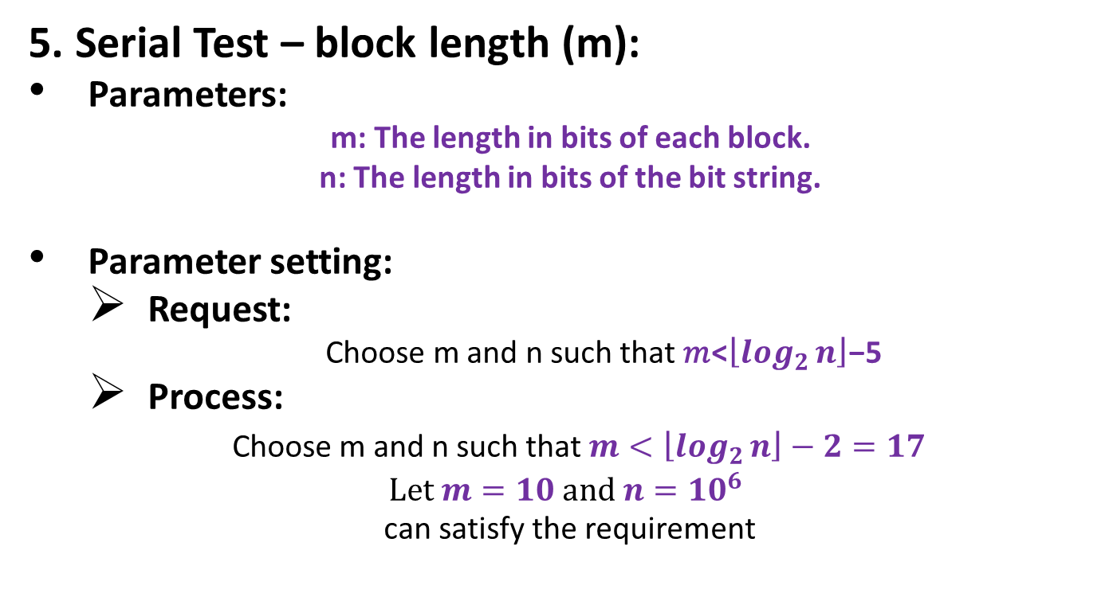
Task – Parameters Setting
5. Serial Test – block length (m):
Parameters:
m: The length in bits of each block.
n: The length in bits of the bit string.
Parameter setting:
Request:
Choose m and n such that 𝑚<$\left\lfloor \log_{2}{n}\right\rfloor$−5
Process:
Choose m and n such that $m<\left\lfloor \log_{2}{n}\right\rfloor −2=17$
$$\text{L}\text{et} m=10 and n={10}^{6}$$
can satisfy the requirement

Slide 14
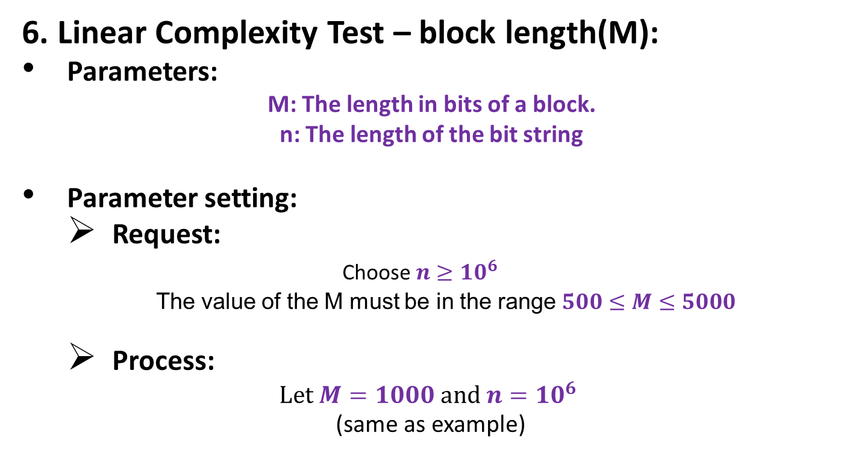
Task – Parameters Setting
6. Linear Complexity Test – block length(M):
Parameters:
M: The length in bits of a block.
n: The length of the bit string
Parameter setting:
Request:
Choose $n≥{10}^{6}$
The value of the M must be in the range $500≤M≤5000$
Process:
$$\text{L}\text{et} M=1000 and n={10}^{6}$$
(same as example)

Slide 15
Task – Parameters Setting Result
Parameter Adjustments | #
Block Frequency Test – block length(M) | 12500
NonOverlapping Template Test – block length(m): | 9
Overlapping Template Test – block length(m): | 10
Approximate Entropy Test – Test length(m): | 10
Serial Test – block length(m): | 10
Linear Complexity Test – block length(M): | 1000

Slide 16
Q3. What is the pass rate of your 100 random number files?

Slide 17
Task – Analyze TRNG data with Test Suite
測試100個file跑NIST SP800-22 test suite後的pass rate:
定義:
對於一個file來說，其finalAnalysisReport中，
188 個test中（包含subtest），有任何一個test fail
出現（i.e.*標示），則視該file為fail case。
結果：
PASS RATE = 53%
在全部100個file中，只有53個 file通過全 部測試。

Slide 18
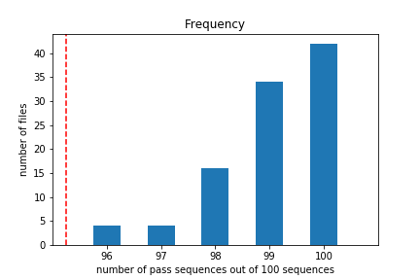
Test(1/15): The Frequency Test.
PASS RATE: 100%

Slide 19
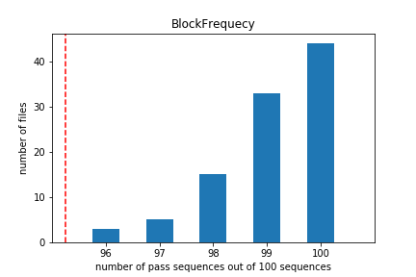
Test(2/15): Frequency Test within a Block.
PASS RATE: 100%

Slide 20
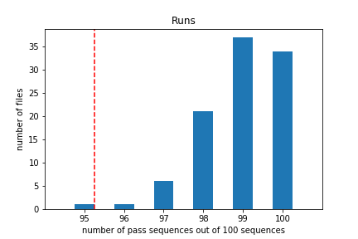
Test(3/15): The Run Test
PASS RATE: 99%

Slide 21
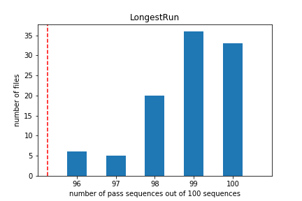
Test(4/15): Tests for the Longest-Run-of-Ones in a Block
PASS RATE: 100%

Slide 22
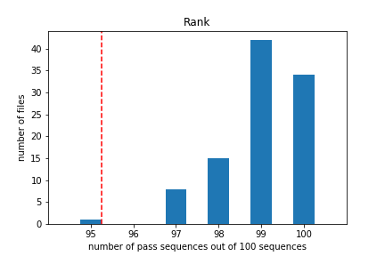
Test(5/15): The Binary Matrix Rank Test
PASS RATE: 99%

Slide 23
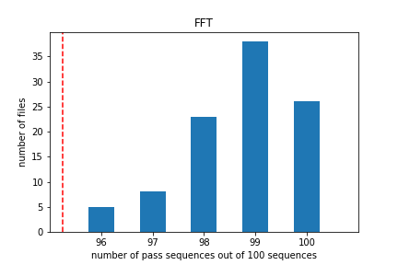
Test(6/15): The Discrete Fourier Transform (Spectral) Test
PASS RATE: 100%

Slide 24
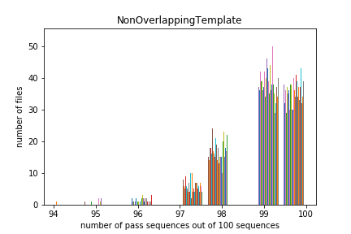
Test(7/15): The Non-overlapping Template Matching Test
*PASS RATE: 58%

Slide 25
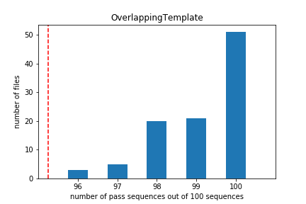
Test(8/15): The Overlapping Template Matching Test
PASS RATE: 100%

Slide 26
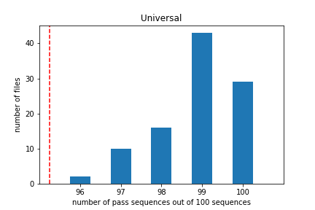
Test(9/15):Maurer’s “Universal Statistical” Test
PASS RATE: 100%

Slide 27
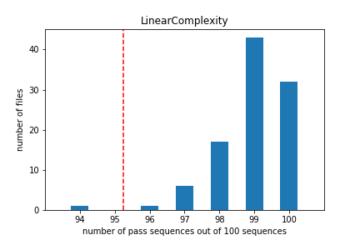
Test(10/15):The Linear Complexity Test
PASS RATE: 99%

Slide 28
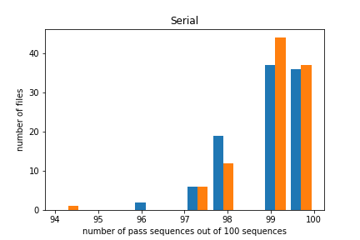
Test(11/15):The Seiral Test
PASS RATE in mode0: 100%
PASS RATE in mode1: 99%

Slide 29
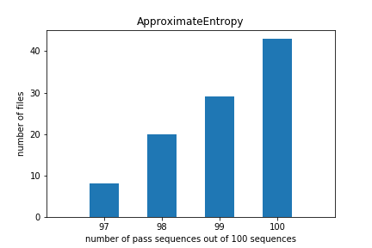
Test(12/15):The Approximate Entropy Test
PASS RATE: 100%

Slide 30
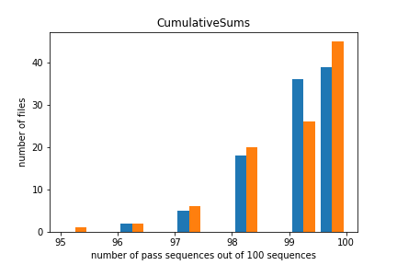
Test(13/15):The Cumulative Sums(Cusums) Test
PASS RATE in mode0: 100%
PASS RATE in mode1: 99%

Slide 31
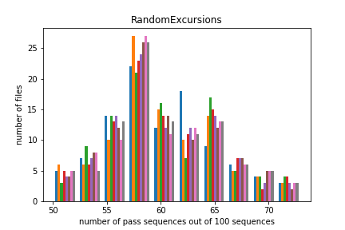
Test(14/15): The Random Excursions Test
PASS RATE: 98%

Slide 32
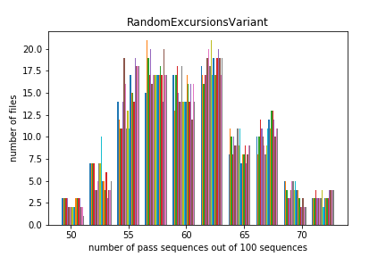
Test(15/15): The Random Excursions Variant Test
PASS RATE: 98%

Slide 33
Q4. Analysis the most frequently failed test and explain why

Slide 34
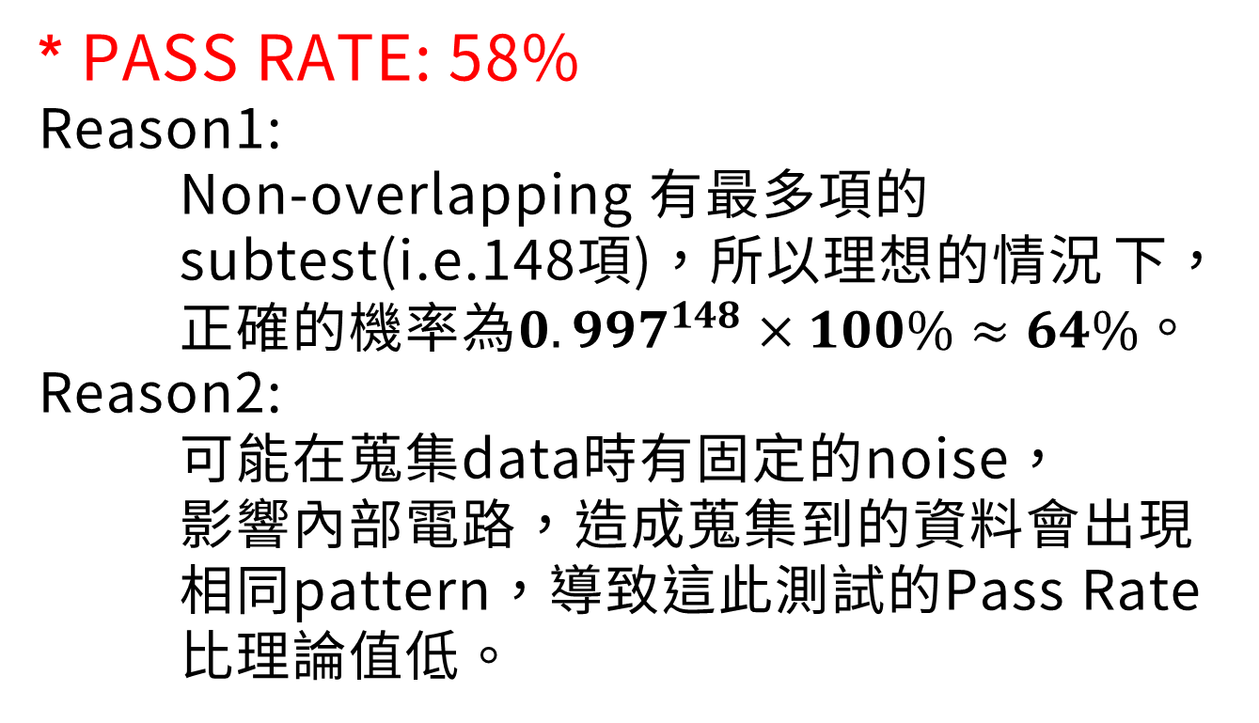
The Non-overlapping Template Matching Test
* PASS RATE: 58%
Reason1:
Non-overlapping 有最多項的 subtest(i.e.148項)，所以理想的情況 下， 正確的機率為$0.997^{148}×100\%≈64\%。$
Reason2:
可能在蒐集data時有固定的noise， 影響內部電路，造成蒐集到的資料會出現 相同pattern，導致這此測試的Pass Rate 比理論值低。

Slide 35
Q5. How do you judge the TRNG you used in this course?

Slide 36
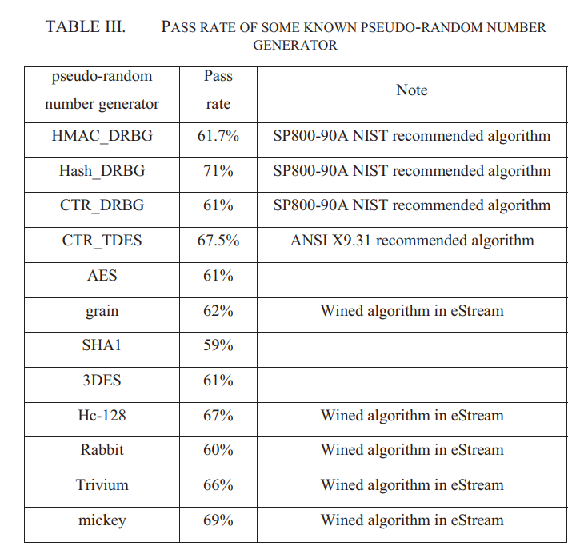
Compare with other known PRNGs
PASS RATE = 53%

Slide 37
Compare with Python Random NUMBER Generator
 | TEST BOARD | PYTHON CODE
TOTAL PASS RATE | 53/ 100 (53%) | 4/ 10 (40%)
Failed mostly TEST | Non-Overlapping | Non-Overlapping
Non-Overlapping PASS RATE | 58/ 100(58%) | 4/10 (40%)
Result | better | -

Slide 38
Analysis:
Reason1:
蒐集的Data量不足，每個file只取100行不足以準確地判斷出
亂數的好壞，很可能我們蒐集到的資料較多分布在極端區間的
隨機亂數，導致最終的PASS RATE 與理想值有落差。
Reason2:
從記憶體讀取資料出來的時候可能會發生錯誤，即使使用
majority voting來降低錯誤率，仍不能完全避免。
Reason3:
因為process variation, 每一個記憶體單元都有些微的差異，
不會是理想的。所以有些cell讀取出來的資料天生0與1的機率
不對等。

